Slide 1
Policy Billing &
Collections Engine
HIGH AVAILABILITY SYSTEM DESIGN

Slide 2
System Overview
Purpose of the System
Automate billing, payment processing, reminders, and delinquency management
Integrate with policy, customer, and notification services
Support secure payment initiation and callback handling
Key Capabilities
Invoice generation
Payment initiation & tracking
Retry workflows
Reminder notifications
Delinquency updates

Slide 3
High‑Level Architecture
Client Applications (Web, Mobile, Internal Ops UI, Batch Scheduler)
Load Balancer (L4/L7)
API Gateway (JWT, routing, rate limiting, WAF)
Billing & Collections Microservice
Policy Service + DB
Customer Service + DB
Notification Service
Payment Gateway Adapter
External Payment Provider (Webhook callbacks)
Kafka Event Bus
Billing DB

Slide 4
Single Point of Failure Assessment
Load balancer
Active/active cluster – 3 nodes behind anycast IP
API gateway
Stateless replicas × 3 – JWT carried in token, no session
Billing microservice
K8s deployment replicas=3
Billing DB
PostgreSQL primary + hot standby + read replica
Kafka event bus
3-broker cluster, replication factor = 3
Circuit breaker
Resilience4j per pod – CB + bulkhead + timeout
Idempotency store
Redis cluster – idempotency keys TTL=24h
Transactional outbox
DB write + Kafka publish in one transaction
Multi-AZ deployment
Identical stack mirrored in AZ-2, DNS failover

Slide 5
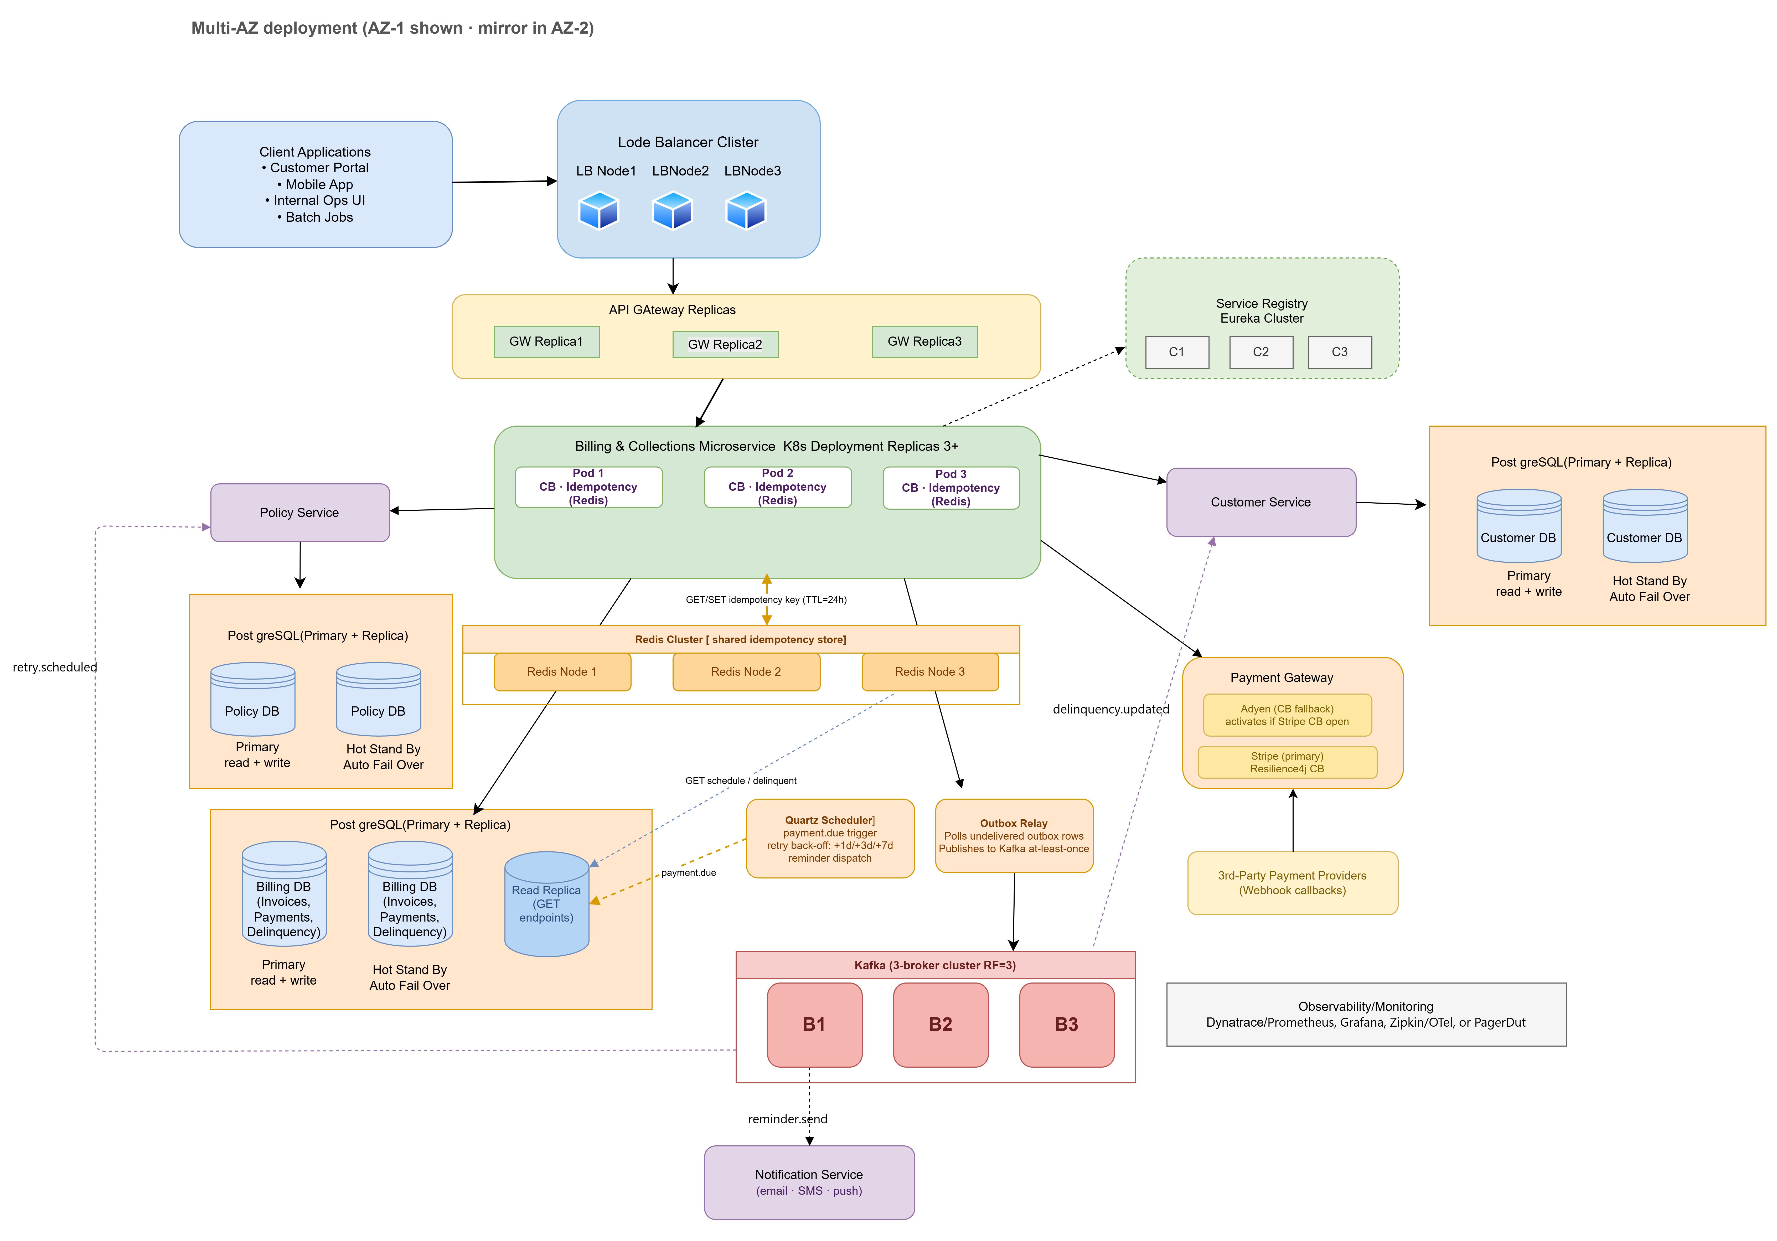
System Design Diagram

Slide 6
Production HA Patterns
Circuit breaker (Resilience4j)
Idempotency store (Redis)
Transactional outbox
Per pod · wraps every GatewayClient call
Per pod · checked before every payment charge
DB write + Kafka event in a single database transaction
▸ CLOSED — calls pass through normally
▸ Key = invoiceId + attemptNumber (e.g. PAY-INV-1001-3)
▸ Payment row and outbox row written atomically
▸ OPEN — trips after 50% error rate; rejects instantly, prevents thread pile-up
▸ Check Redis BEFORE touching the DB or calling the gateway
▸ Outbox relay reads undelivered rows → publishes to Kafka
▸ HALF-OPEN — after cooldown, test calls determine recovery
▸ Cache result on success with TTL = 24h
▸ If pod crashes after DB commit but before Kafka publish — relay retries
▸ Bulkhead limits concurrent gateway threads to 20
▸ Duplicate call returns cached result — customer never double-charged
▸ Guarantees at-least-once event delivery to all consumers
▸ Timeout: 3 s gateway call max — never blocks indefinitely
▸ Redis runs in cluster mode across both AZs
▸ Eliminates lost delinquency.updated and payment.failed events

Slide 7
Payment Lifecycle — Reminder → Retry → Gateway
1
Quartz scheduler fires
Delinquency state machine
Detects premium due date → publishes payment.due to Kafka
CURRENT
On-time payment
2
Reminder sent
Days past due: 0
ReminderService → email/SMS/push via NotificationClient
GRACE
Missed due date
5-step transaction
Days past due: 1–7
3
Idempotency → lock → PROCESSING → gateway call → commit + outbox
WARNING
Retry 2 failed
Days past due: 8–30
4
Gateway call (CB)
Stripe/Adyen via Resilience4j · HMAC webhook verification
LAPSED
Retry 3 failed
Days past due: 31–90
5
SUCCESS path
Mark PAID · clear delinquency · publish payment.success
CANCELLED
Max escalation
Days past due: 90+
6
FAILED path
RetryService queues: +1d → +3d → +7d back-off ladder

